Slide 1
Automating Image Extraction from PDF (V2)
Objective: To automate the extraction of images from PDF Files
Kobe Chang
12/17/2021

Slide 2
Automating Image Extraction from PDF
Requirements
Ensure that EXTRACTING_IMAGES_Ivan_v2.py and RUNNING.PY_FILE.ipynb file are both downloaded and have directory set to where the folder containing the PDF files are
Open the .py file as notepad and change the path to the tesseract exe file
If the EXTRACTING_IMAGES_Ivan_v2.py file can’t be run by double clicking, ensure that Jupyter notebook is downloaded and execute RUNNING.PY_FILE.ipynb from Jupyter notebook.
Launch Jupyter notebook and install:
Pymupdf
Pandas
Opencv-python
Pytesseract

Slide 3
Automating Image Extraction from PDF
Script Main Requirements
Script is able to find all the PDF files in the folder
Script is able to crop the images correctly based on the filetype:
BLD : Extract Top and Side Images from the Main Image and merged together and superimpose y distance values onto the image
Flatness: Extract Top Image from Main Image and superimpose ISO Flatness onto the image
Roughness: Extract Top Image from Main Image and superimpose SA onto the image
3. Script will rename the pictures correctly based on the new_filename given from the Dataframe(df_path)

Slide 4
Automating Image Extraction from PDF
Script Plan
Find all the PDF files and form a Data frame
Create a function to get the main image from the PDF
Create function to crop main image accordingly
For Flatness & Roughness files
Create a function to resize and superimpose the values
For BLD Files
Create a function to Merge and superimpose image
Create function to place text onto the images
Create function to save all images into the folder
Create function to extract the text via OCR (ML) from the images
Create a function that loops through every row in the file path, file type and new name columns of the Data frame and passes each record to the function that gets the main image
Create another function to get the type (BLD…) of the picture

Slide 5
Automating Image Extraction from PDF
Script Flow
Functions run automatically
CWD_Walk_Level_v5 ()
Goes through directory and returns dataframe
Call Main ()
Loop through rows of dataframe and saves the extracted images
get_main_image()
Gets the main image from the PDF
get_type()
Checks the image type
get_new_image()
Checks the image type and crop accordingly
get_text()
Crops image to get text accordingly
A

Slide 6
Automating Image Extraction from PDF
Script Flow (Continuation) → A
Functions run automatically
A
imagecrop()
Crops the image to get either the top or side view
mergeimage()
Merges top and side view and also superimposes the required text
resize_and_superimpose_image()
Resizes text , then superimposes onto the extracted images
textpos()
Position the text onto the images
saveimage()
Saves the cropped images into a folder located in the current directory

Slide 7
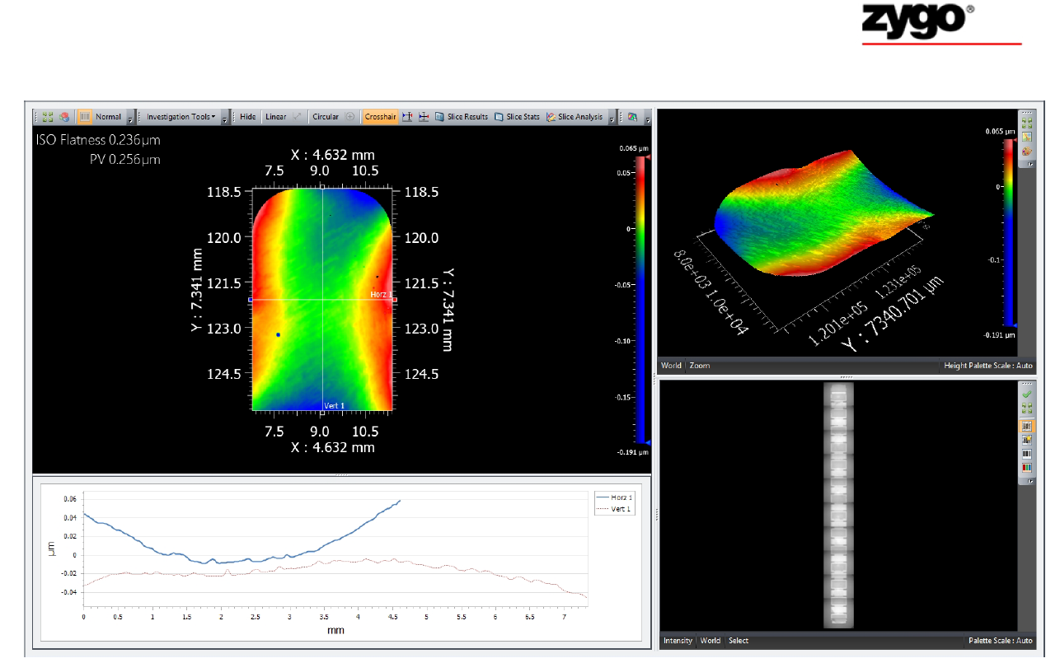
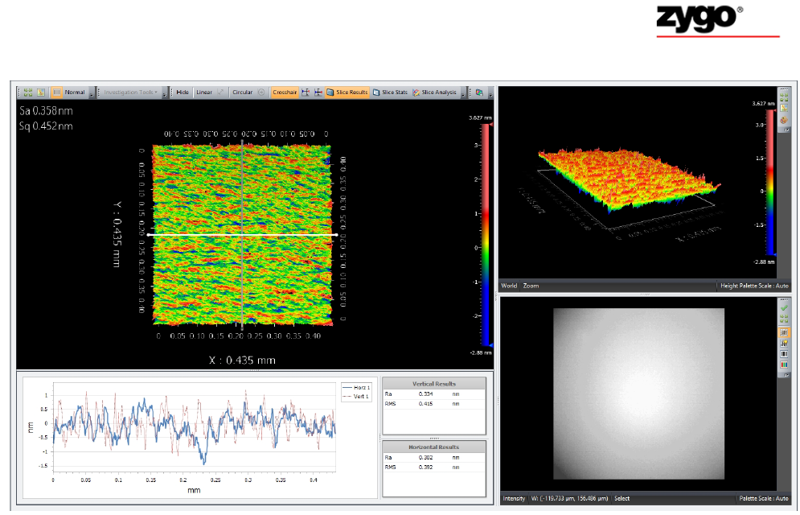
Automating Image Extraction from PDF
PDF file format Type 1 & 2 → Flatness & Roughness file
Flatness
Roughness
For the Flatness files type.
Extract image & crop only the top view (highlighted in dotted Red box)
Extract the ISO flatness value with OCR processing.
For the Roughness file type
Extract image & crop only the top view (highlighted in dotted Red box)
Extract the Sa value with OCR processing

Slide 8
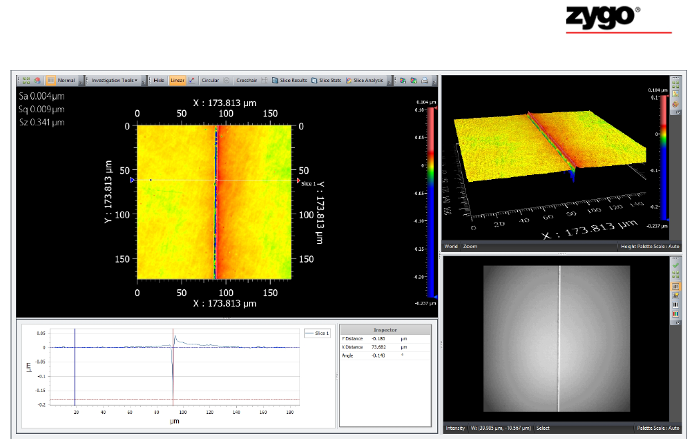
Automating Image Extraction from PDF
PDF file format Type 3 → BLD file
BLD
For the BLD file type
Extract image from pdf.
Crop the top view left and right area. (highlighted in dotted Red box)
Extract the Y distance value from the bottom middle (highlighted in the dotted Red box)with OCR processing.
Merge both top view left and right area into 1 new image.

Slide 9
Automating Image Extraction from PDF
Limitations of the script
The script is dependent on where the .py file is placed and the folder format of where the PDF files are stored
The filename of the extracted images are not accurate

Slide 10
Automating Image Extraction from PDF
Difficulties & Lessons Learnt
Difficulties
Cropping the image without having to save it
Taking care of variations with the folder format
Identifying the file type from the images
Extracting text via OCR takes a long time
Extracting text via OCR is not completely accurate
Taking care of the variability of values returned from the OCR
Finding out the positional points to use for the cropping of the image for all 3 files
Lessons Learnt
Breaking down of the problem into smaller parts is very important
Learning how to pass multiple parameters through functions
Cropping the image to improve speed & accuracy is essential
Understanding the need to have robust functions
Learning how to work with Images and Data structures such as Pixmap
Ran through possible variations (-,+,.) of the text output from OCR(ML)
Made more educated guesses to determine the positional points used for cropping

Slide 11
Automating Image Extraction from PDF
Time Saved (Simulated & Validated)
Time saved: 44.6% (4 mins 50 sec)
Time saved: 57.7% (24 mins 30 sec)
Time saved: 65.7% (57 mins 30 sec)
Assumptions
Assume that there will be time lag of ~10s after every 5 Pictures due to Human intervention
Have to take into context that Humans will be distracted and ultimately spend more time on the image extraction than is assumed
The total time spent will vary from person to person , thus the time saved could be even more than is shown above
Task | Time Spent for 1 picture
Without the PDF Extraction automation ( Open PDF → Crop → Paste & arrange in ppt → Labelling ) | 60s
With the PDF Extraction automation ( User copy extracted image after automation → Paste & arrange in ppt ) | 36s
V2 improvement coming soon
Time Saved: 40% Per Picture
Validated with Han Nee. (Up to 5 pictures)

Slide 12
Automating Image Extraction from PDF
Execute file name and snapshots
Contains the .py file
Download EXTRACTING_IMAGES_Ivan_v2.py
Download RUNNING.PY_FILE.ipynb
Visit this link & Download :(tesseract-ocr-w64-setup-v5.0.0-alpha.20210811.exe (64 bit))
https://github.com/UB-Mannheim/tesseract/wiki

